Slide 1

Programming Assignment 3 RSA-based Public Key Distribution Authority (PKDA)
Project-1

Slide 2
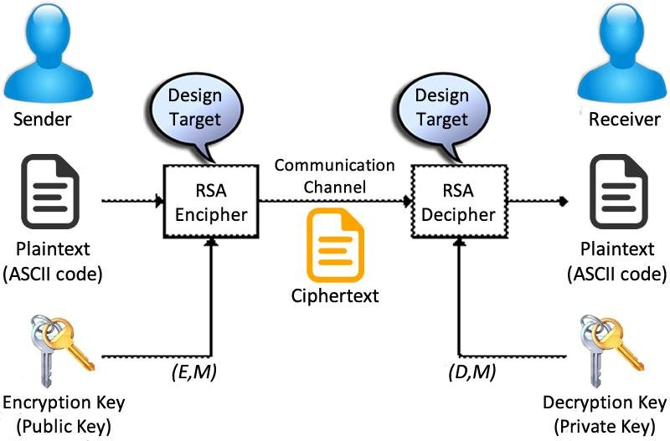
RSA
RSA (Rivest-Shamir-Adleman) is an asymmetric cryptographic technique used for secure online data transfer. It uses two keys for each user: a public key for encrypting messages and a private key for decrypting them. RSA's security relies on the challenge of factoring large numbers.
The process involves key generation, encryption, and decryption.

Slide 3
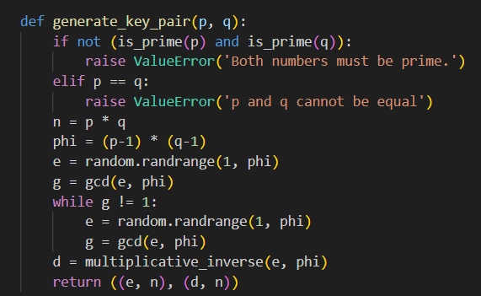
Key Generation
Select p and q as two very large prime numbers(the larger the number, higher the security)
Calculate n = p * q
Calculate Φ= (p- 1) * (q- 1)
Choose e such that 1 <= e < Φ and gcd(e, Φ) = 1
d =e⁻¹ mod Φ
Public key pair = {e, n}, Private key pair = {d, n}

Slide 4
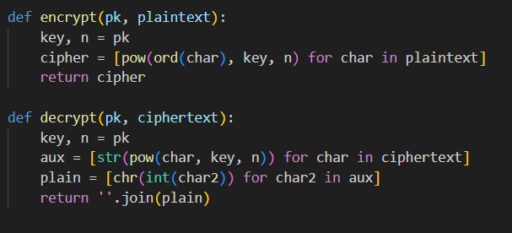
Encryption & Decryption
Calculate and return ciphertext = pow(plaintext, e, n) or C = Me mod n
Calculate and return plaintext = pow(ciphertext, d, n) or M = C^{d} mod n

Slide 5
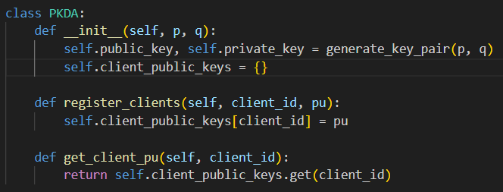
PDKA
A PKDA (Public Key Distribution Authority) system securely distributes public keys to clients. Clients sign up for the PKDA's public key and request others'. The PKDA facilitates encrypted messaging, storing public keys openly. Clients sign up with the PKDA in such a system to receive the PKDA's public key.
To send a message, a client asks PKDA for the recipient's public key. If obtained, the message is encrypted before sending, ensuring secure communication without direct key sharing. PKDA manages key distribution for communication security.

Slide 6
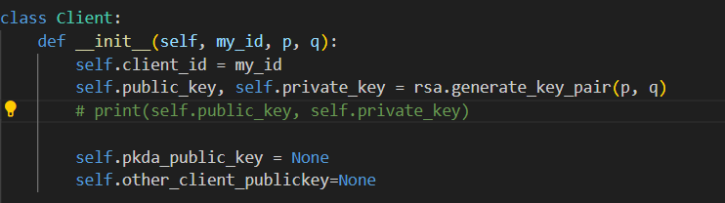
Clients
Client initializes with an ID and generates RSA public-private key pair.
Registers itself with the PKDA server, sending its public key.
Requests the public key of another client from the PKDA server.
Sends a handshake request to establish a secure connection with the other client. Client 2 receives handshake.
Sends "Hi" messages encrypted with the other client's public key and receives acknowledgment.

Slide 7

Thanks!
Krishna Somani 2021058
Mayank Gupta 2021065

